Slide 1
Geo Location Based Research Project Indexing Solution
By
Harshit Yadav

Slide 2
Abstract
Traditional open Source projects and research indexing databases works using search keywords and key Value pair match parameters for the published well structured data, a lot of undocumented research literature , Partial results and datasets gets discarded which might contain some valuable insights which could be later picked later for further research and development .In the proposed system ,geo tagging is used on such data aiding to faster discovery

Slide 3

Motivation
To Harness more resource available online
Speed up the Process of Research
Utilize the Unstructured Data
More Oriented toward applied research and faster Prototyping
Collective Collaboration

Slide 4

Introduction
Rise of Open Source Platforms
Data Sets and Models and lots of new formats of unstructured data doesn't get indexed and discarded.
Current Indexing portal are based on keywords only
Geolocation will add a whole new aspect to indexing and discovery

Slide 5

Literature Review and Survey
Rise of New Gps Data and Geotag data available
Open Source Platforms
Proprietary solutions
Recently Filed Patents in India
Recent R&D and product developments in this area

Slide 6
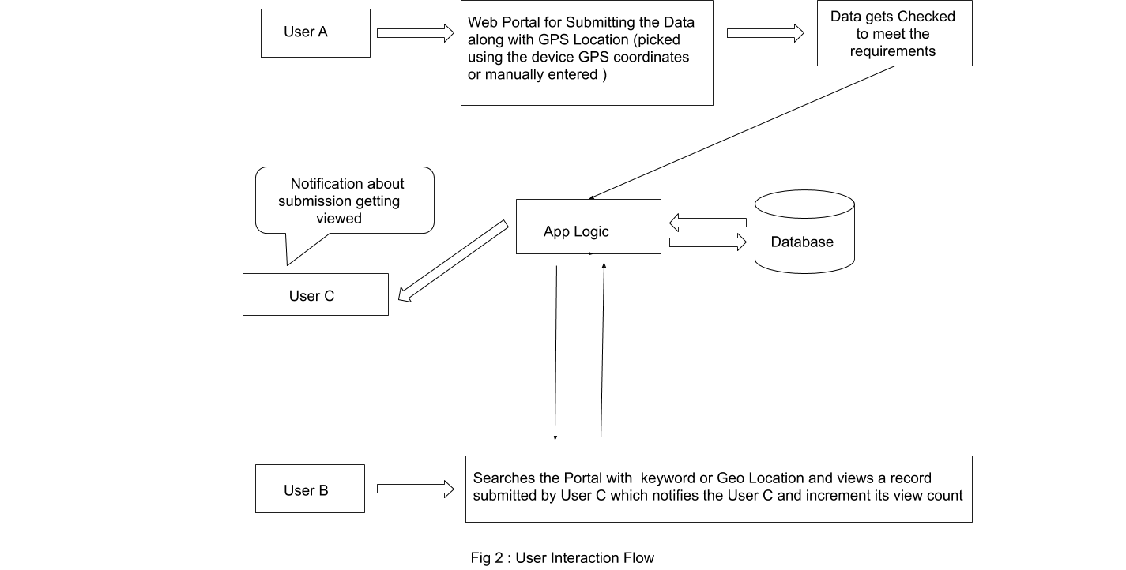
Proposed Solution

Slide 7
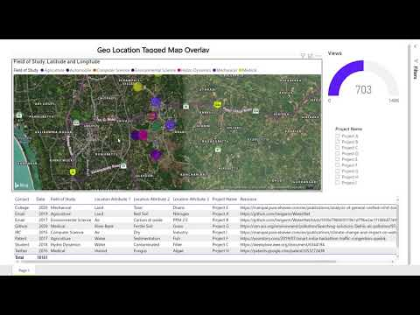
Demo

Slide 8
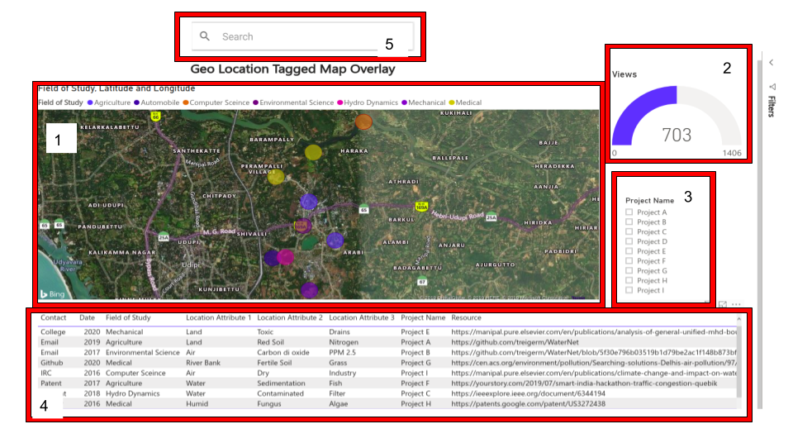
User Interface

Slide 9
Conclusion
The proposed system is an innovative architect solution
for indexing ,utilizing research data which shall be
optimised in future. This generic architecture applicable
across large domain or field with varying expertise ,
moreover this project is commercially viable product which
could be implemented in a short time .

Slide 10
Thank You

